Slide 1
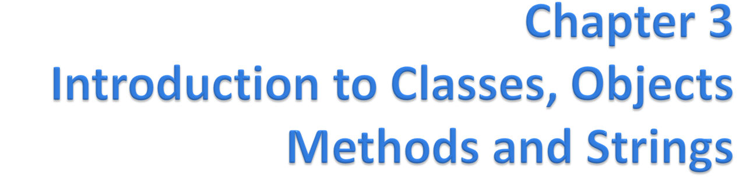
Java™ How to Program, 9/e
© Copyright 1992-2012 by Pearson Education, Inc. All Rights Reserved.

Slide 2
© Copyright 1992-2012 by Pearson Education, Inc. All Rights Reserved.

Slide 3
© Copyright 1992-2012 by Pearson Education, Inc. All Rights Reserved.

Slide 4
Starter
Write down attributes and actions for a real-world object (e.g., a mobile phone).
© Copyright 1992-2012 by Pearson Education, Inc. All Rights Reserved.

Slide 5

Attributes
  Brand
  Model
  Color
  Camera Resolution (Front/Back)
  Size
  Battery capacity
  Signal Strength
  …
Operations
  Call
  Send Message
  Connect/Disconnect Internet
  Lock/Unlock
  Scroll up/down
  Scan Fingerprint
  Volume Up/Down
  Flash on/off
  Take Image
  Shoot Video
  ...

Slide 6

Covered in this chapter
  Classes
    Fields
    Methods
  Creating and using Objects
  Setter/getter methods
  UML Class Diagram
  Constructor
  double primitive type
© Copyright 1992-2012 by Pearson Education, Inc. All Rights Reserved.

Slide 7
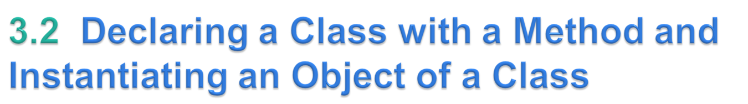
Create a new class (GradeBook)
Use it to create an object.
Each class declaration that begins with keyword public must be stored in a file that has the same name as the class and ends with the .java file-name extension.
Keyword public is an access modifier.
  Indicates that the class is “available to the public”
© Copyright 1992-2012 by Pearson Education, Inc. All Rights Reserved.

Slide 8
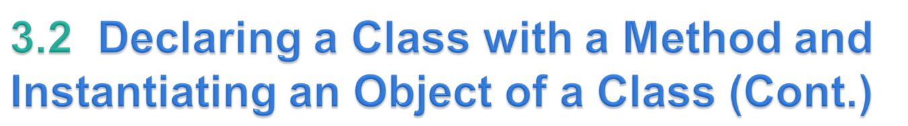
The main method is called automatically by the Java Virtual Machine (JVM) when you execute an application.
A public is “available to the public”
  It can be called from methods of other classes.
The return type specifies the type of data the method returns after performing its task.

Slide 9
Method name follows the return type.
By convention, method names begin with a lowercase first letter and subsequent words in the name begin with a capital letter.
Empty parentheses after the method name indicate that the method does not require additional information to perform its task.
Together, everything in the first line of the method is typically called the Method header
Every method’s body is delimited by left and right braces.
The method body contains one or more statements that perform the method’s task.
© Copyright 1992-2012 by Pearson Education, Inc. All Rights Reserved.

Slide 10
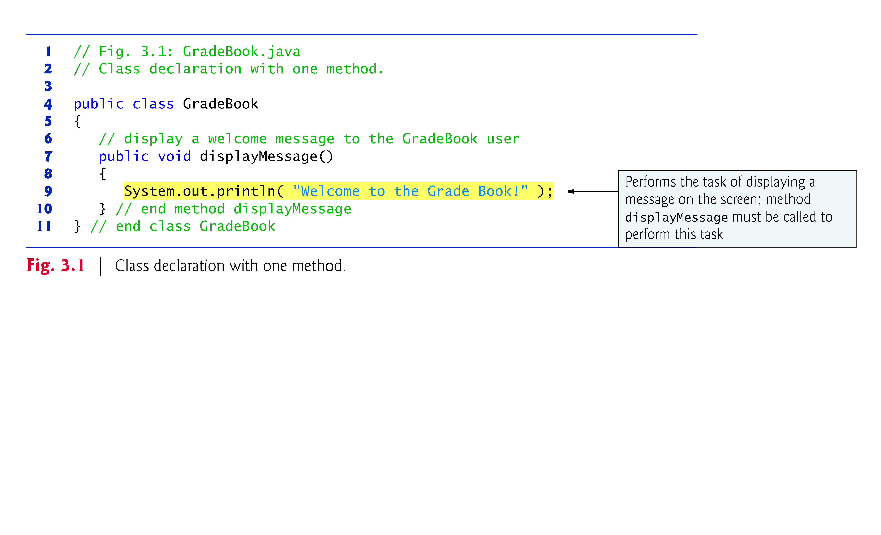
© Copyright 1992-2012 by Pearson Education, Inc. All Rights Reserved.

Slide 11
Use class GradeBook in an application.
Class GradeBook is not an application because it does not contain main.
Can’t execute GradeBook; will receive an error message like:
    Exception in thread "main" java.lang.NoSuchMethodError: main
Must either declare a separate class that contains a main method or place a main method in class GradeBook.
To help you prepare for the larger programs, use a separate class containing method main to test each new class.
Some programmers refer to such a class as a driver class.
© Copyright 1992-2012 by Pearson Education, Inc. All Rights Reserved.

Slide 12
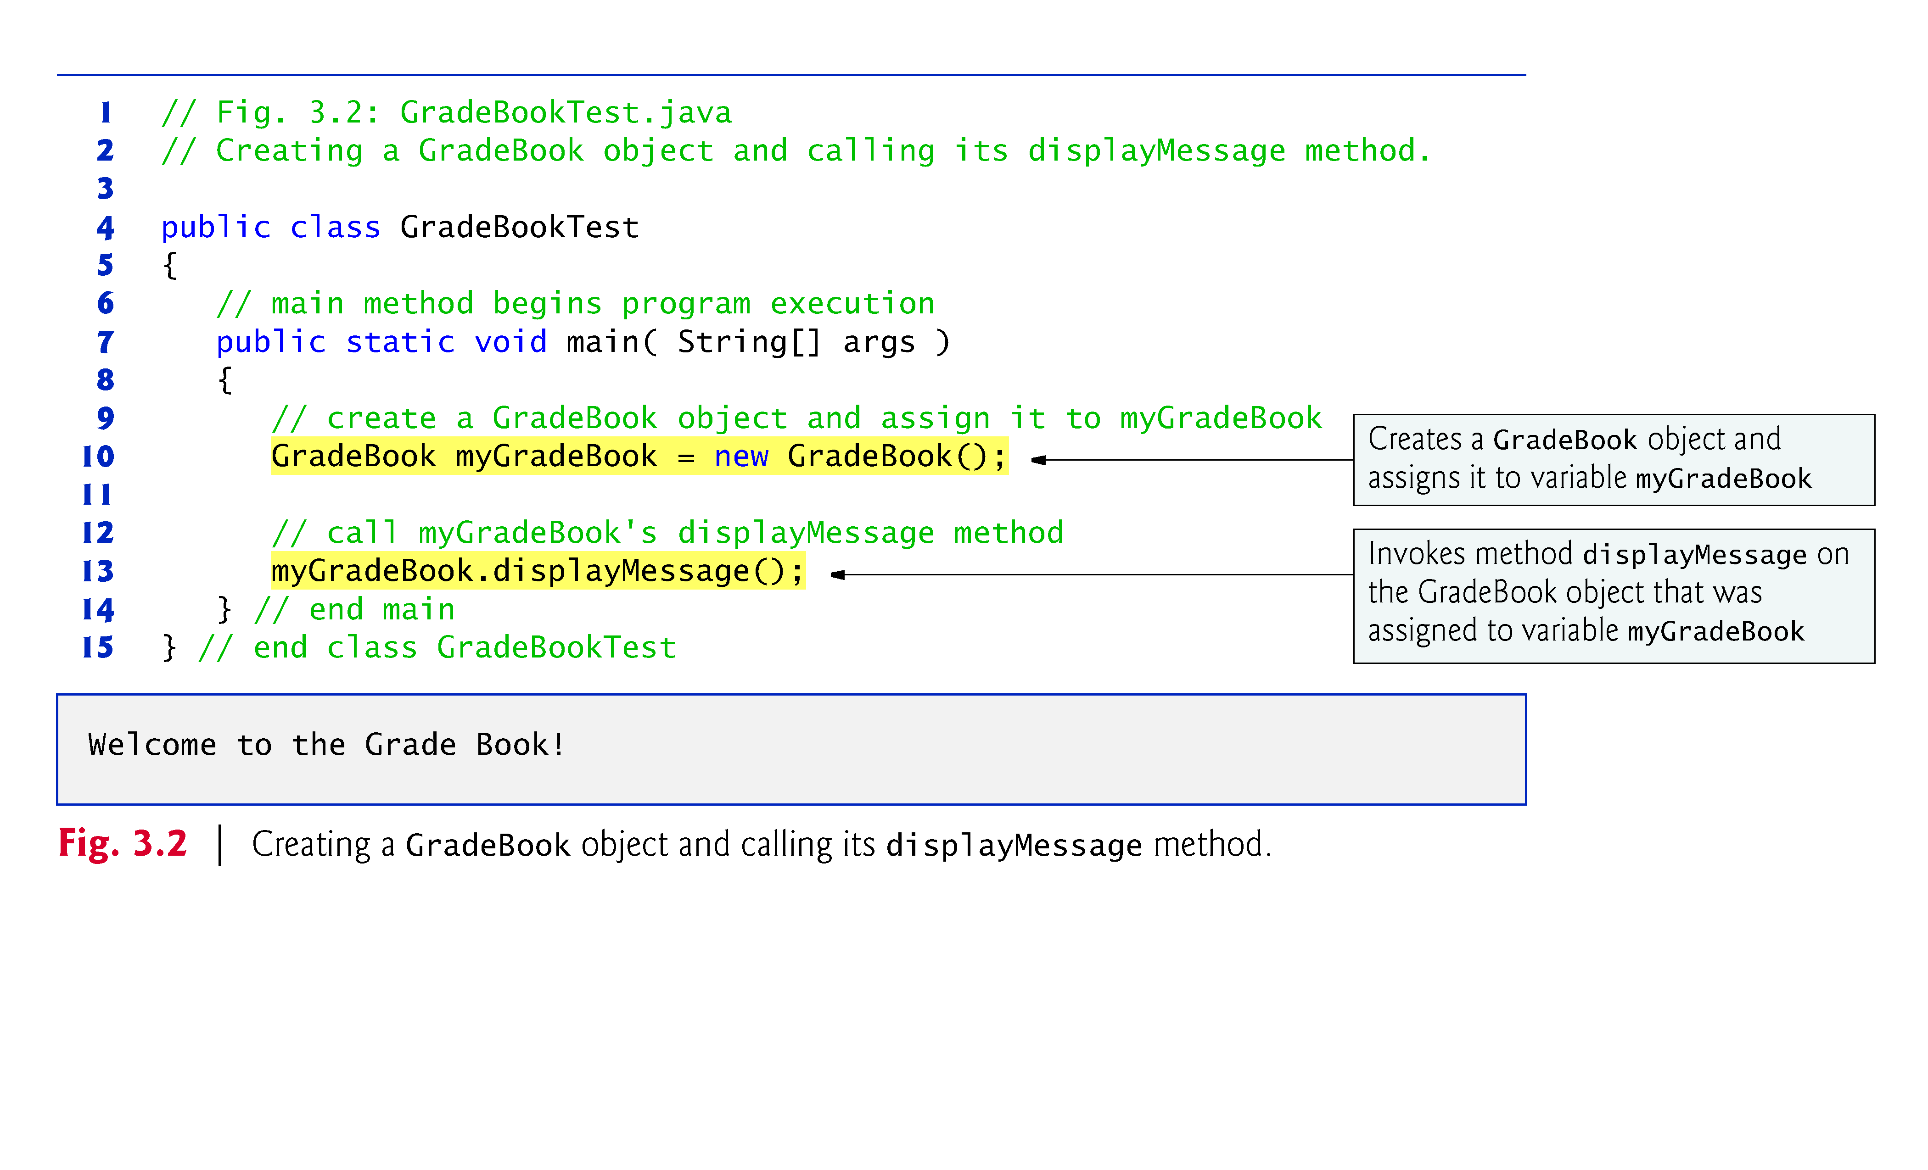
© Copyright 1992-2012 by Pearson Education, Inc. All Rights Reserved.

Slide 13
Declare a variable of the class type.
  Each new class you create becomes a new type that can be used to declare variables and create objects.
  You can declare new class types as needed; this is one reason why Java is known as an extensible language.
© Copyright 1992-2012 by Pearson Education, Inc. All Rights Reserved.

Slide 14
Class instance creation expression
  Keyword new creates a new object of the class specified to the right of the keyword.
    Used to initialize a variable of a class type.
  The parentheses to the right of the class name are required.
  Parentheses in combination with a class name represent a call to a constructor, which is similar to a method but is used only at the time an object is created to initialize the object’s data.
A static method (such as main) is special
  It can be called without first creating an object of the class in which the method is declared.
Typically, you cannot call a method that belongs to another class until you create an object of that class.
© Copyright 1992-2012 by Pearson Education, Inc. All Rights Reserved.

Slide 15
Call a method via the class-type variable
  Variable name followed by a dot separator (.), the method name and parentheses.
  Call causes the method to perform its task.
Any class can contain a main method.
  The JVM invokes the main method only in the class used to execute the application.
    If multiple classes that contain main, then only that main method is executed in only that class, which is provided along the java command
© Copyright 1992-2012 by Pearson Education, Inc. All Rights Reserved.

Slide 16
Compiling an Application with Multiple Classes
  Compile the classes in Fig. 3.1 and Fig. 3.2 before executing.
  Type the command
    javac GradeBook.java GradeBookTest.java
  Then, Type the command
    java GradeBookTest
© Copyright 1992-2012 by Pearson Education, Inc. All Rights Reserved.

Slide 17
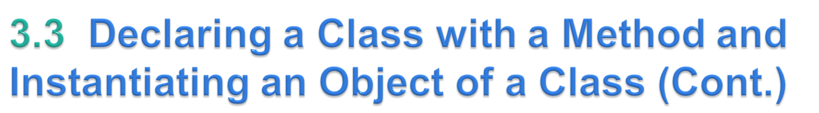
Figure 3.3: UML class diagram for class GradeBook.
Each class is modeled in a class diagram as a rectangle with three compartments.
  Top: contains the class name centered horizontally in boldface type.
  Middle: contains the class’s attributes, which correspond to instance variables (Section 3.5).
  Bottom: contains the class’s operations, which correspond to methods.
Operations are modeled by listing the operation name preceded by an access modifier (in this case +) and followed by a set of parentheses.
The plus sign (+) corresponds to the keyword public.
© Copyright 1992-2012 by Pearson Education, Inc. All Rights Reserved.

Slide 18
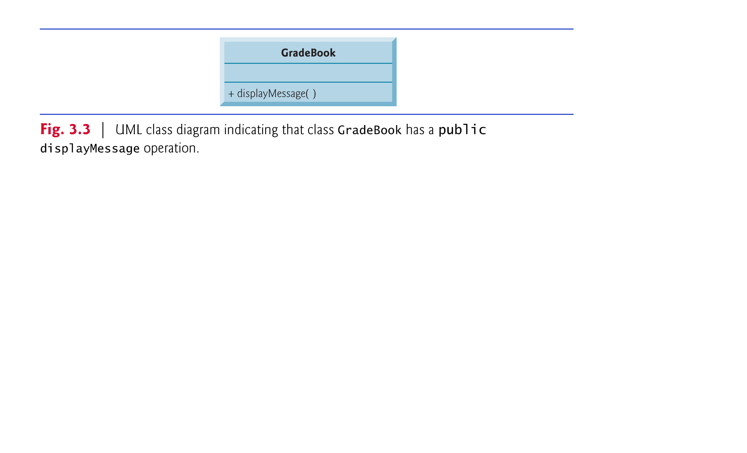
© Copyright 1992-2012 by Pearson Education, Inc. All Rights Reserved.

Slide 19
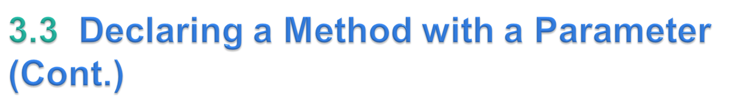
A method can require one or more parameters that represent additional information it needs to perform its task.
  Defined in a comma-separated parameter list
  Located in the parentheses that follow the method name
  Each parameter must specify a type and an identifier.
A method call supplies values—called arguments—for each of the method’s parameters.
© Copyright 1992-2012 by Pearson Education, Inc. All Rights Reserved.

Slide 20
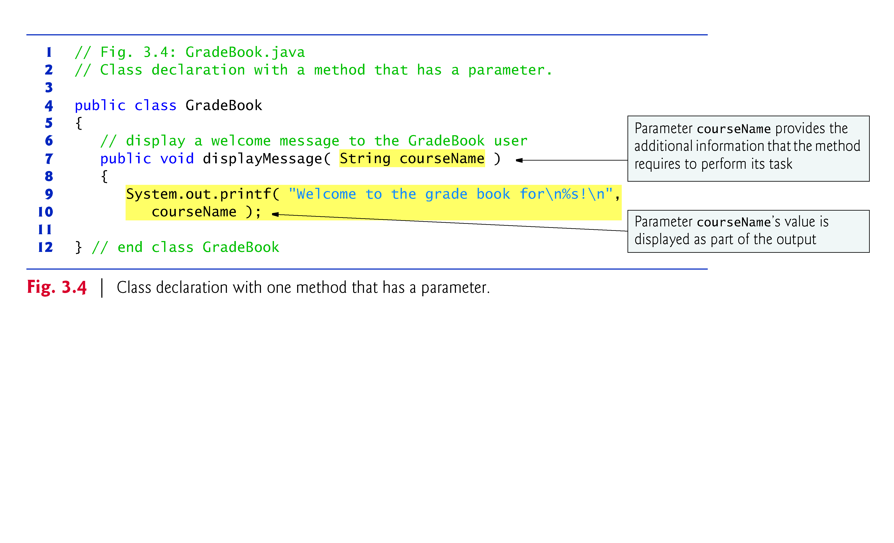
© Copyright 1992-2012 by Pearson Education, Inc. All Rights Reserved.

Slide 21
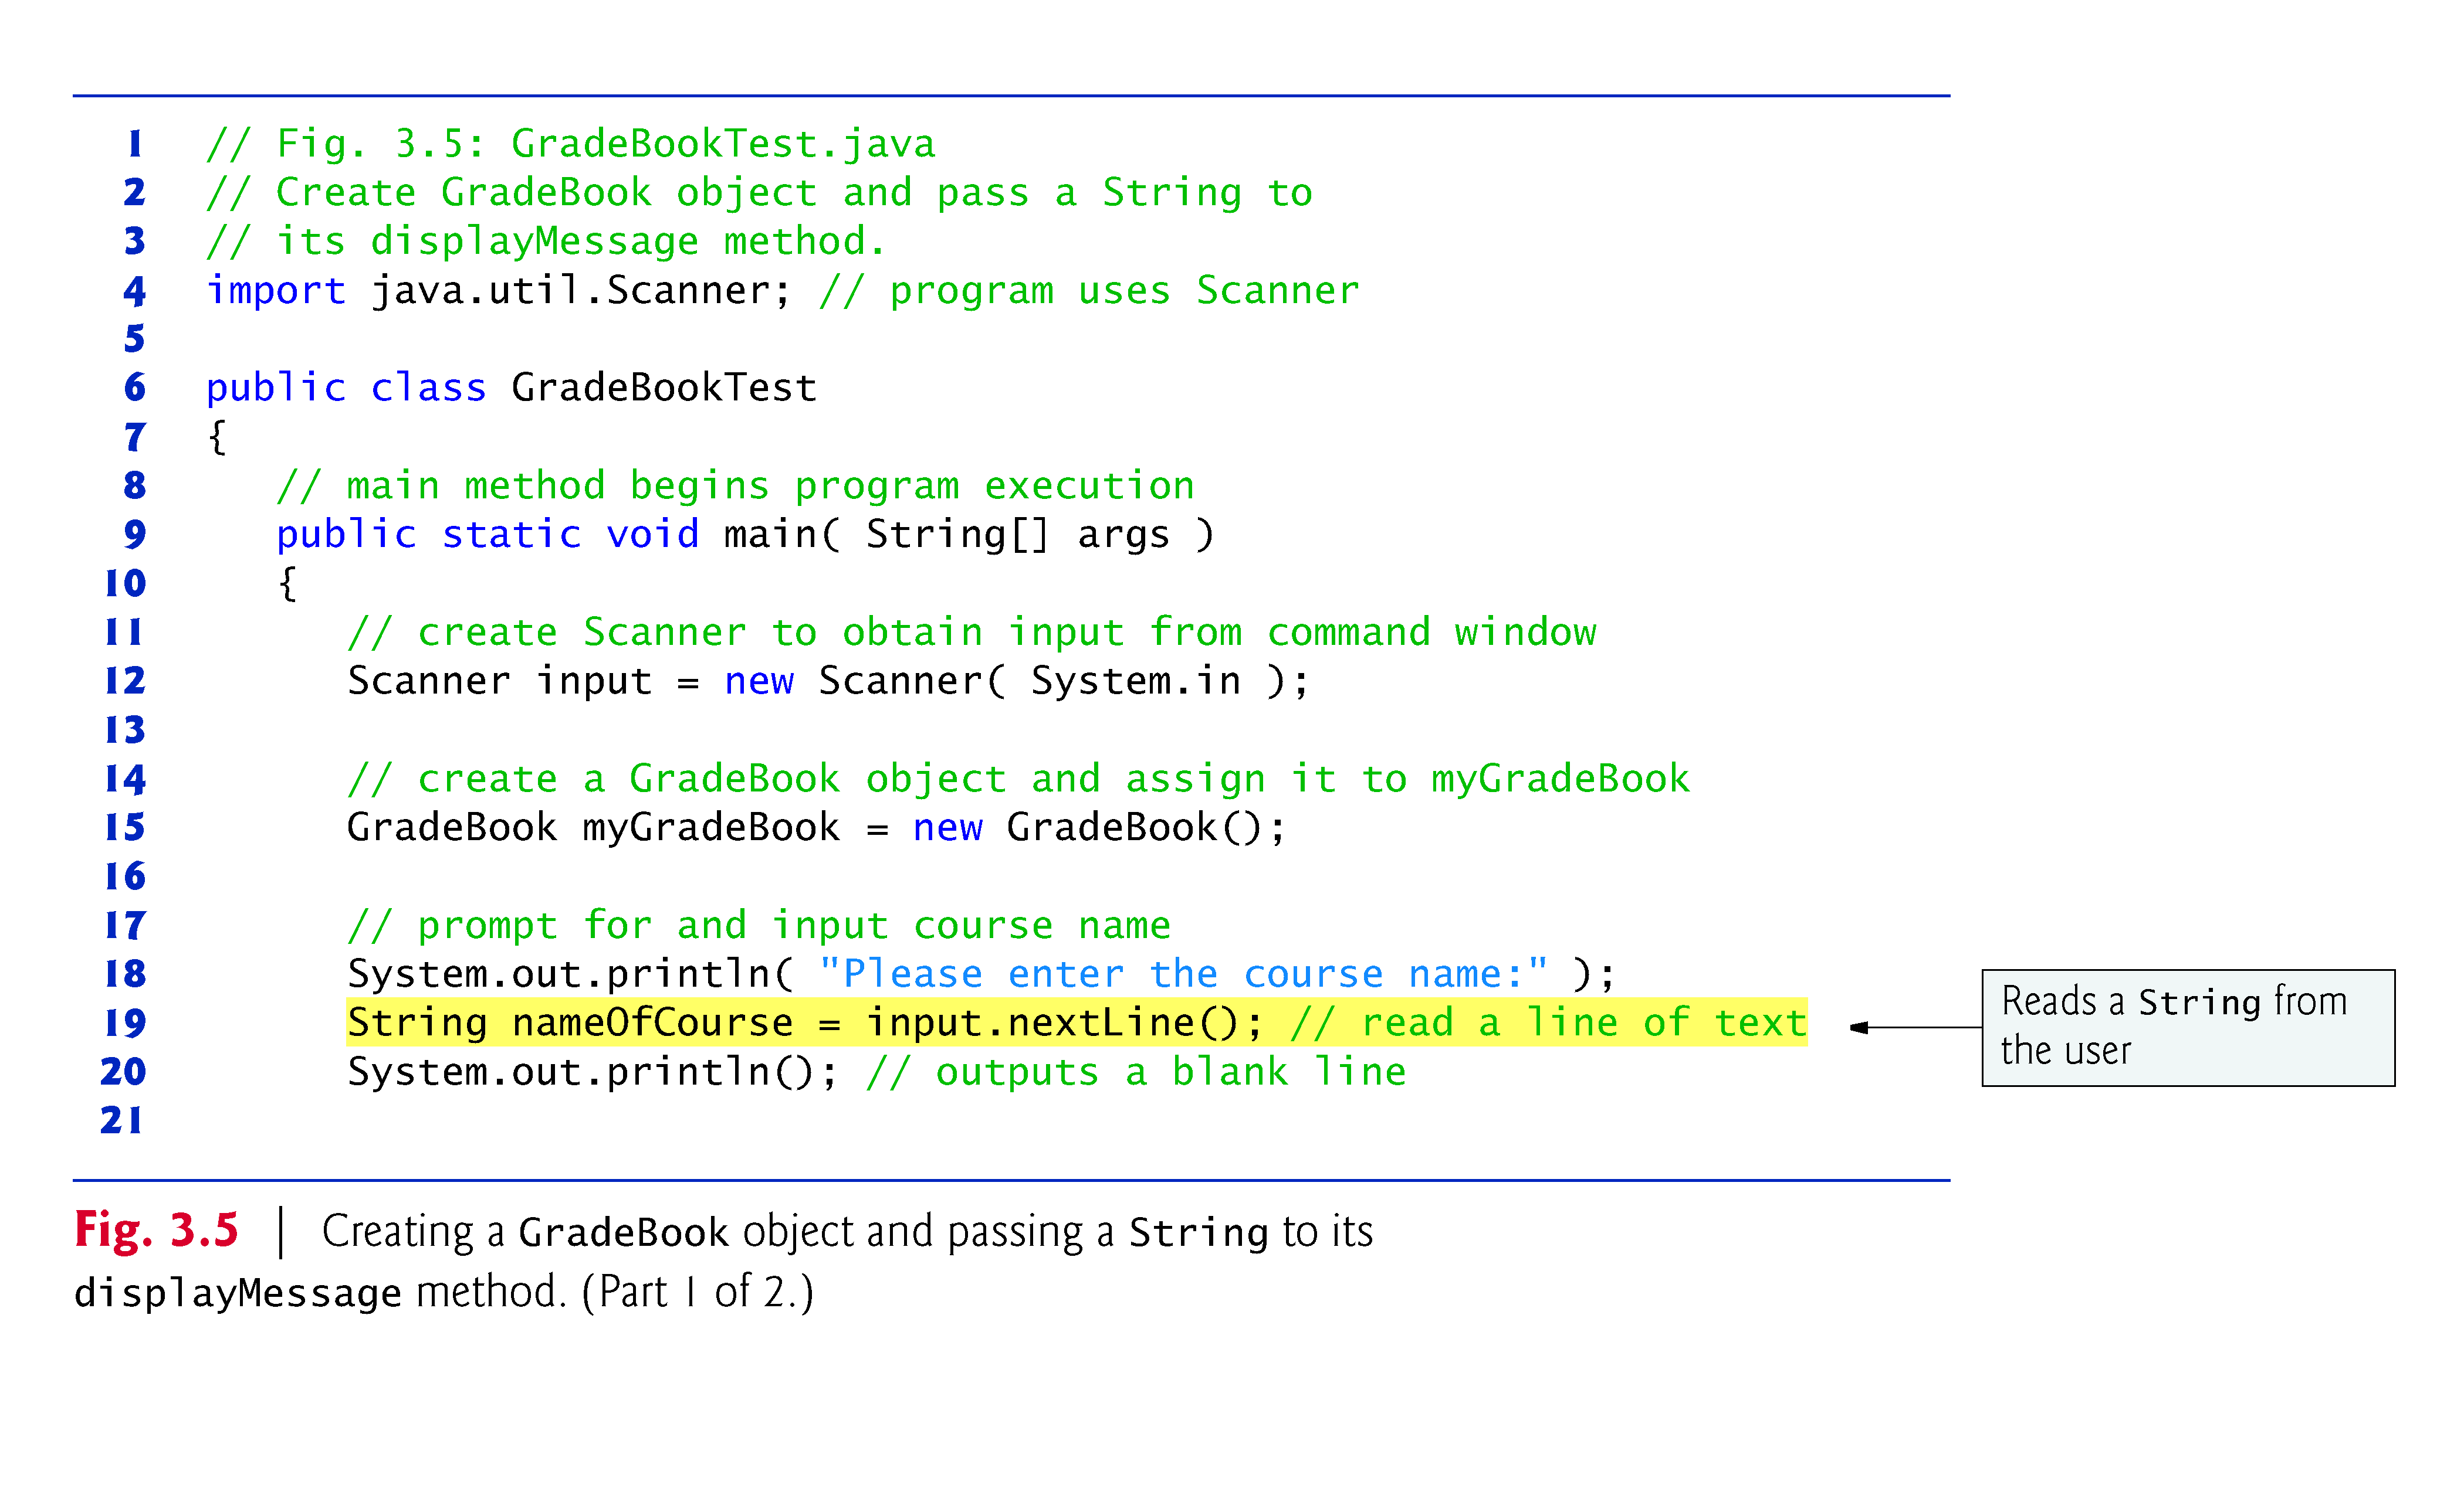
© Copyright 1992-2012 by Pearson Education, Inc. All Rights Reserved.

Slide 22
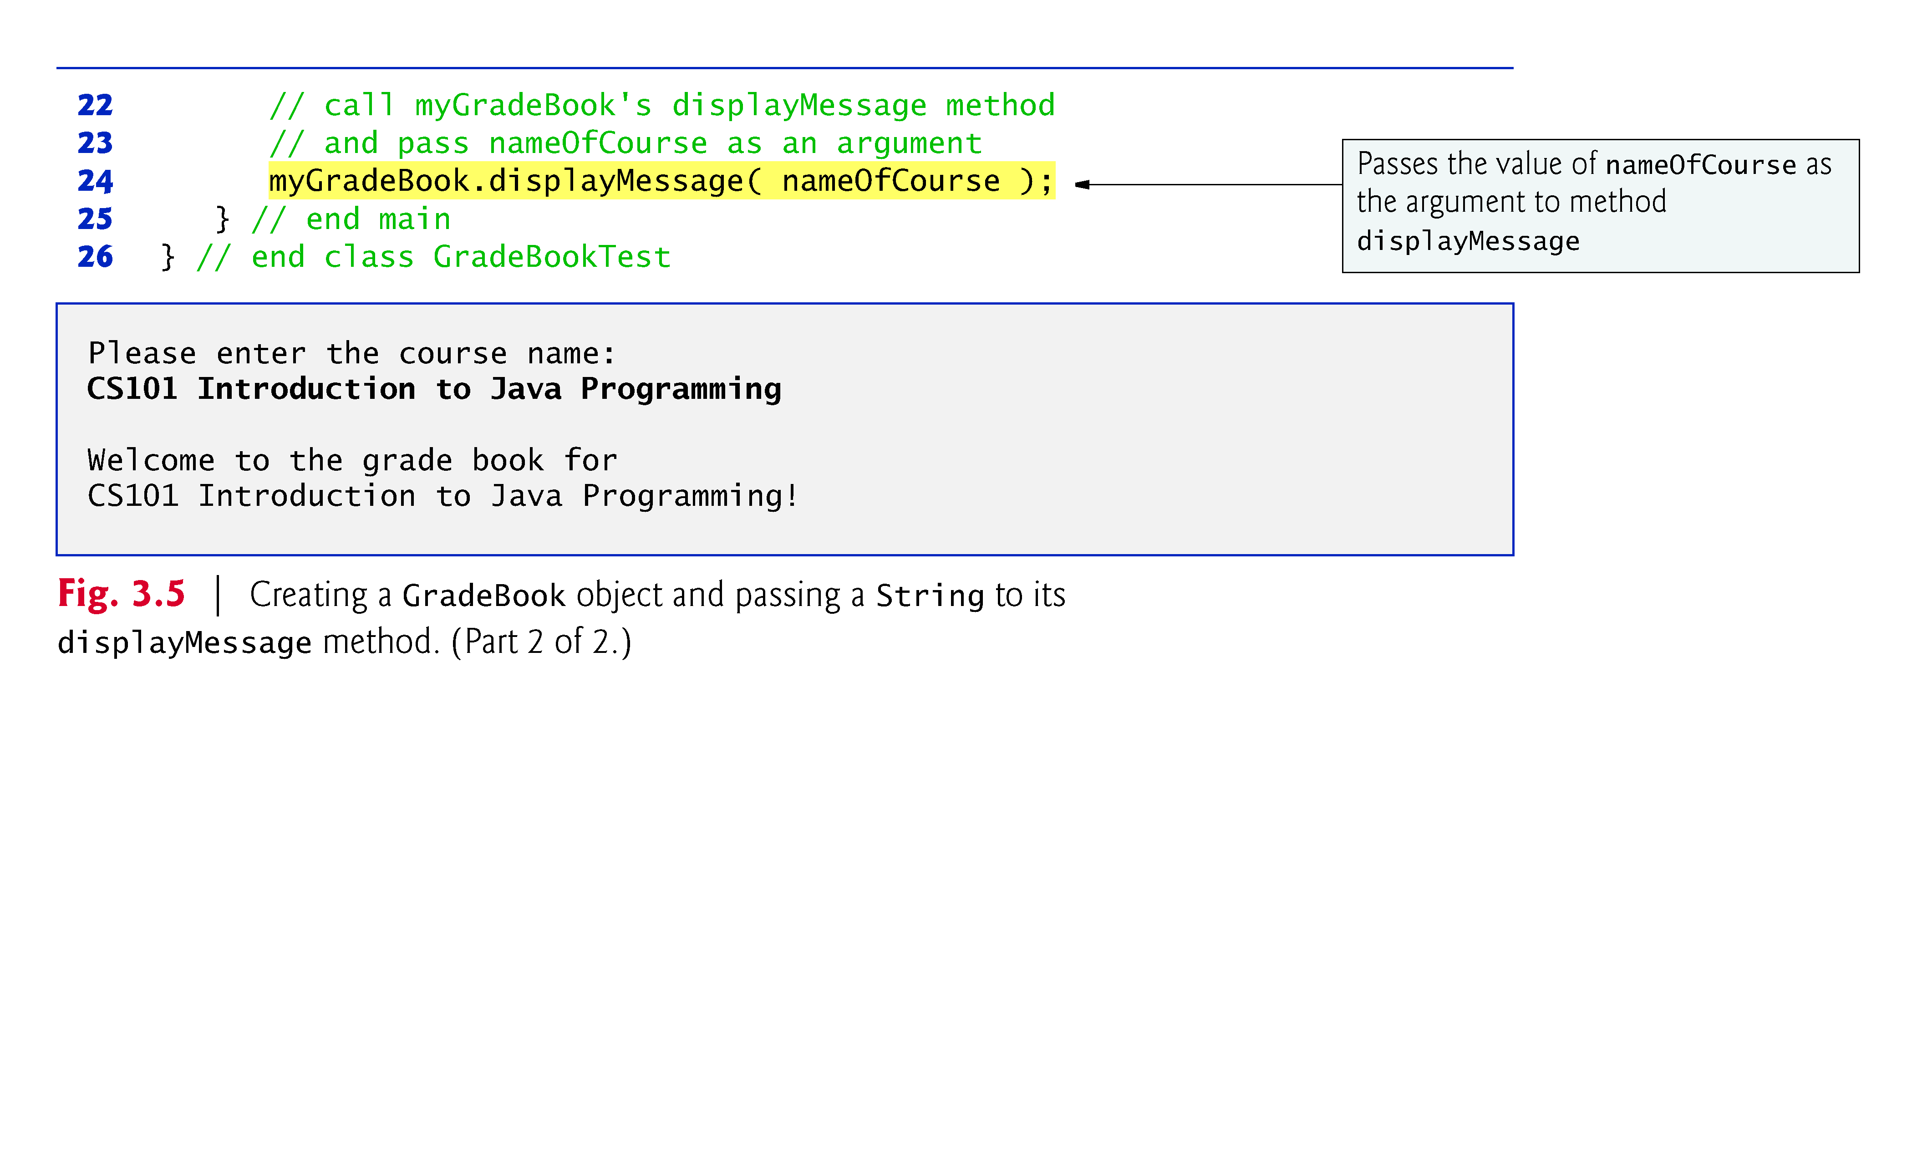
© Copyright 1992-2012 by Pearson Education, Inc. All Rights Reserved.

Slide 23
Scanner method nextLine
  Reads characters typed by the user until the newline character is encountered
  Pressing Enter inserts a newline character at the end of the characters the user typed.
  Returns a String containing the characters up to, but not including, the newline
Scanner method next
  Reads individual words
  Reads characters until a white-space character is encountered, then returns a String (the white-space character is discarded).
  Information after the first white-space character can be read by other statements that call the Scanner’s methods later in the program.
© Copyright 1992-2012 by Pearson Education, Inc. All Rights Reserved.

Slide 24
More on Arguments and Parameters
  The number of arguments in a method call must match the number of parameters in the parameter list of the method’s declaration.
  The argument types in the method call must be “consistent with” the types of the corresponding parameters in the method’s declaration.
© Copyright 1992-2012 by Pearson Education, Inc. All Rights Reserved.

Slide 25
The UML class diagram of Fig. 3.6 models class GradeBook of Fig. 3.4.
The UML models a parameter by listing the parameter name, followed by a colon and the parameter type in the parentheses- following the operation name.
The UML type String corresponds to the Java type String.
© Copyright 1992-2012 by Pearson Education, Inc. All Rights Reserved.

Slide 26
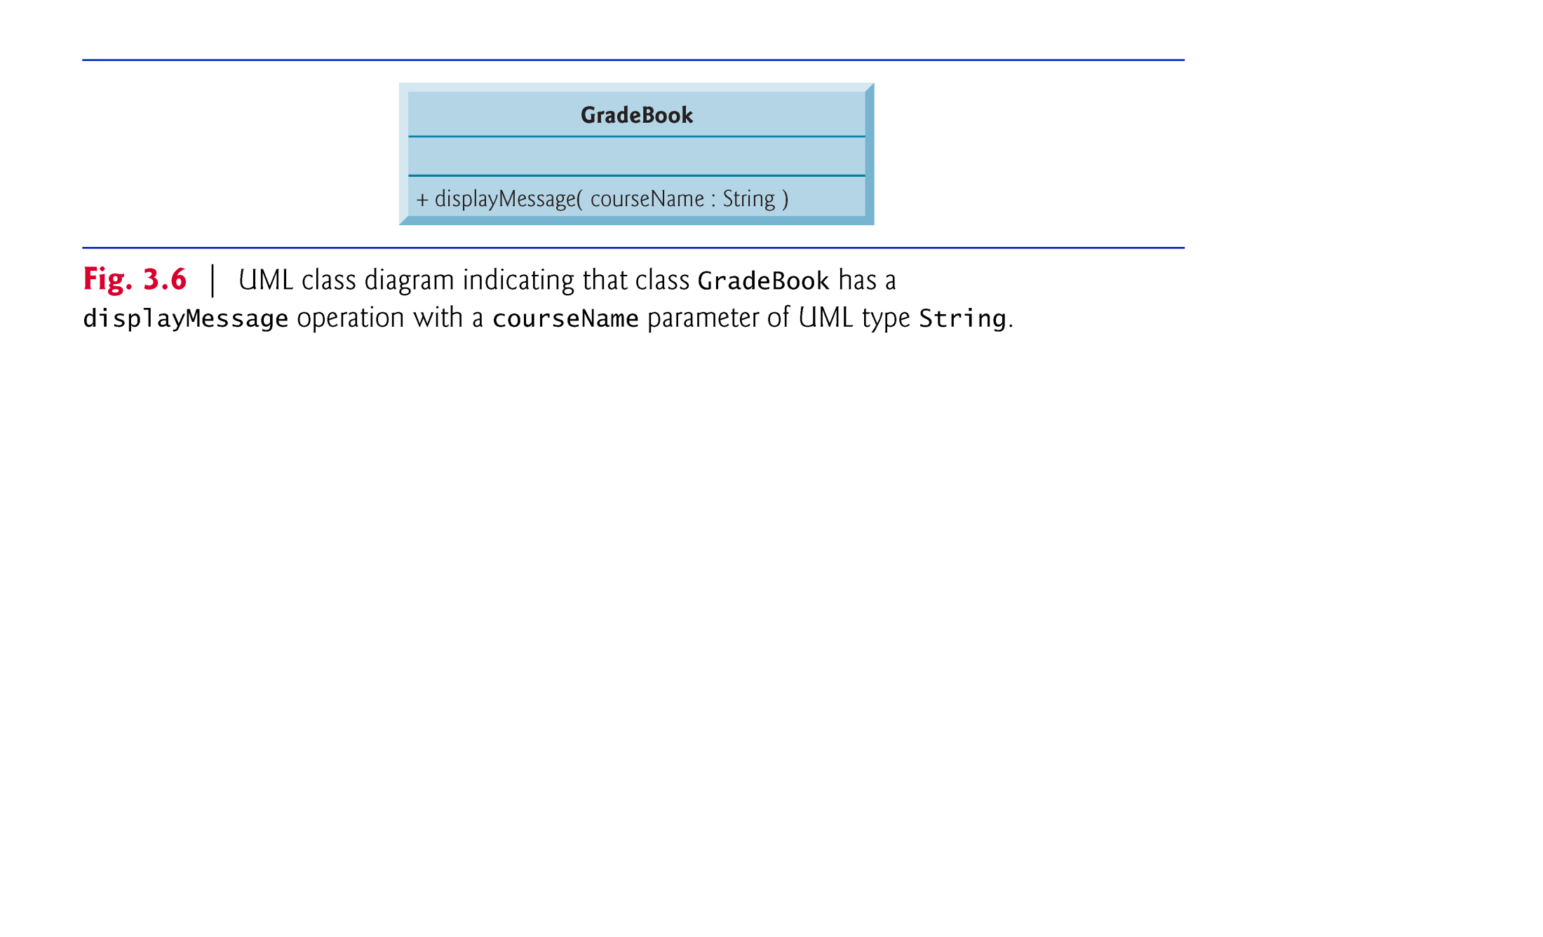
© Copyright 1992-2012 by Pearson Education, Inc. All Rights Reserved.

Slide 27
Notes on import Declarations
  Classes System and String are in package java.lang
    Implicitly imported into every Java program
    Can use the java.lang classes without explicitly importing them
    Most classes you’ll use in Java programs must be imported explicitly.
  Classes that are compiled in the same directory on disk are in the same package—known as the default package.
  Classes in the same package are implicitly imported into the source-code files of other classes in the same package.
© Copyright 1992-2012 by Pearson Education, Inc. All Rights Reserved.

Slide 28

You can create a couple of classes Calculator and CalculatorTest in the same way as GradeBook and GradeBookTest.
  Create methods of your choice in the Calculator class and test them in the CalculatorTest class. Feel free and get creative in the choice of methods you want to include in Calculator class.
Compile Calculator and CalculatorTest classes and run the CalculatorTest multiple times after changing the code in CalculatorTest (Be creative in what to do in CalculatorTest’s main method).
© Copyright 1992-2012 by Pearson Education, Inc. All Rights Reserved.

Slide 29

Local variables
  Variables declared in the body of a particular method.
  When a method terminates, the values of its local variables are lost.
On the other hand, an object has attributes that are carried with the object as it’s used in a program. Such attributes exist before a method is called on an object and after the method completes execution.
© Copyright 1992-2012 by Pearson Education, Inc. All Rights Reserved.

Slide 30

A class normally consists of one or more methods that manipulate the attributes that belong to a particular object of the class.
  Attributes are represented as variables in a class declaration.
  Called fields.
  Declared inside a class declaration but outside the bodies of the class’s method declarations.
  When objects of a class are created, each object has its own copy of fields (now called instance variables)
© Copyright 1992-2012 by Pearson Education, Inc. All Rights Reserved.

Slide 31
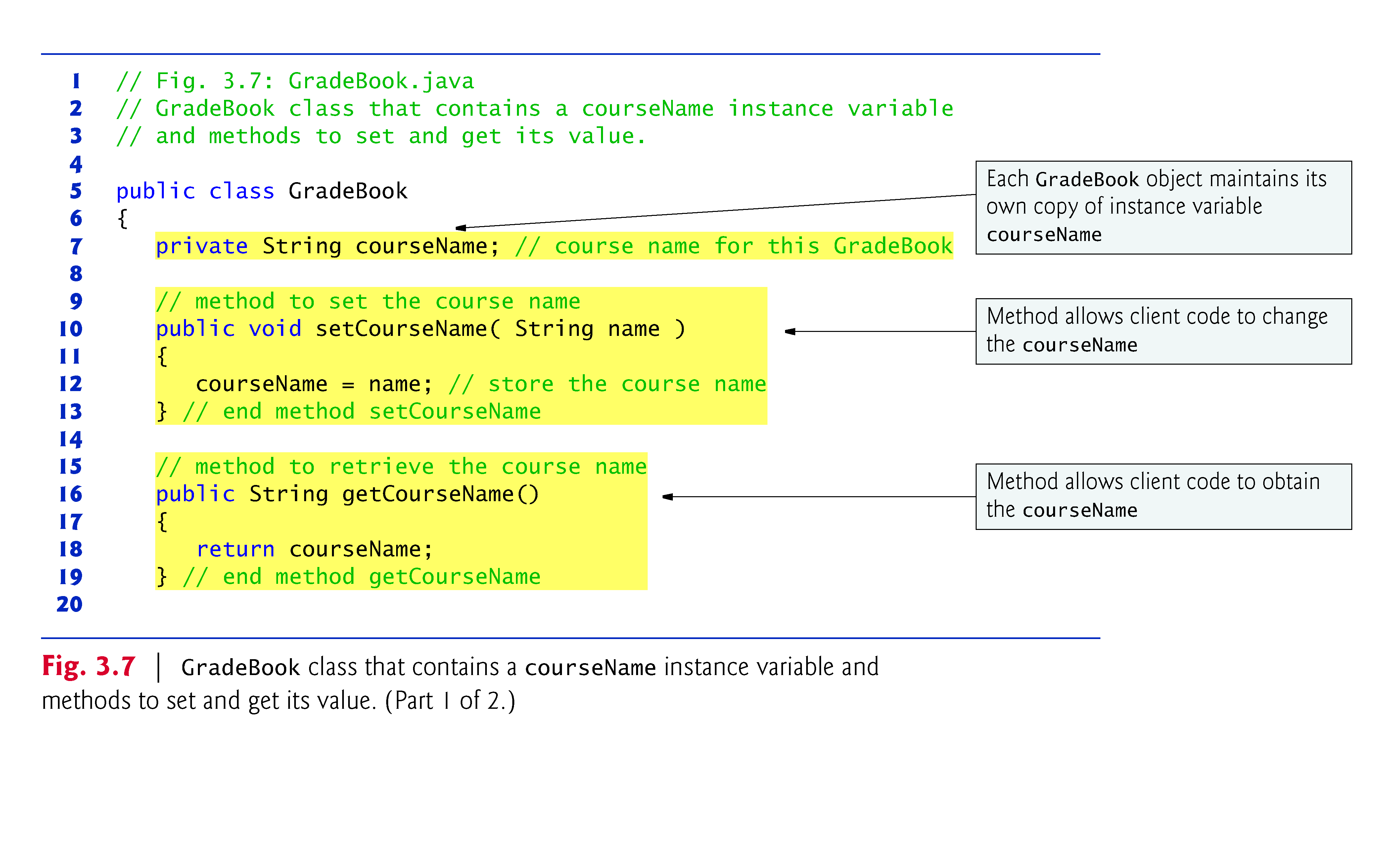
© Copyright 1992-2012 by Pearson Education, Inc. All Rights Reserved.

Slide 32
© Copyright 1992-2012 by Pearson Education, Inc. All Rights Reserved.

Slide 33
Instance variables typically declared private.
  private is an access modifier.
  private variables and methods are accessible only to methods of the class in which they are declared.
Declaring instance private is known as data hiding or information hiding.
private variables are encapsulated (hidden) in the object and can be accessed only by methods of the object’s class.
  Prevents instance variables from being modified accidentally by a class in another part of the program.
  Set and get methods used to access instance variables.
© Copyright 1992-2012 by Pearson Education, Inc. All Rights Reserved.

Slide 34
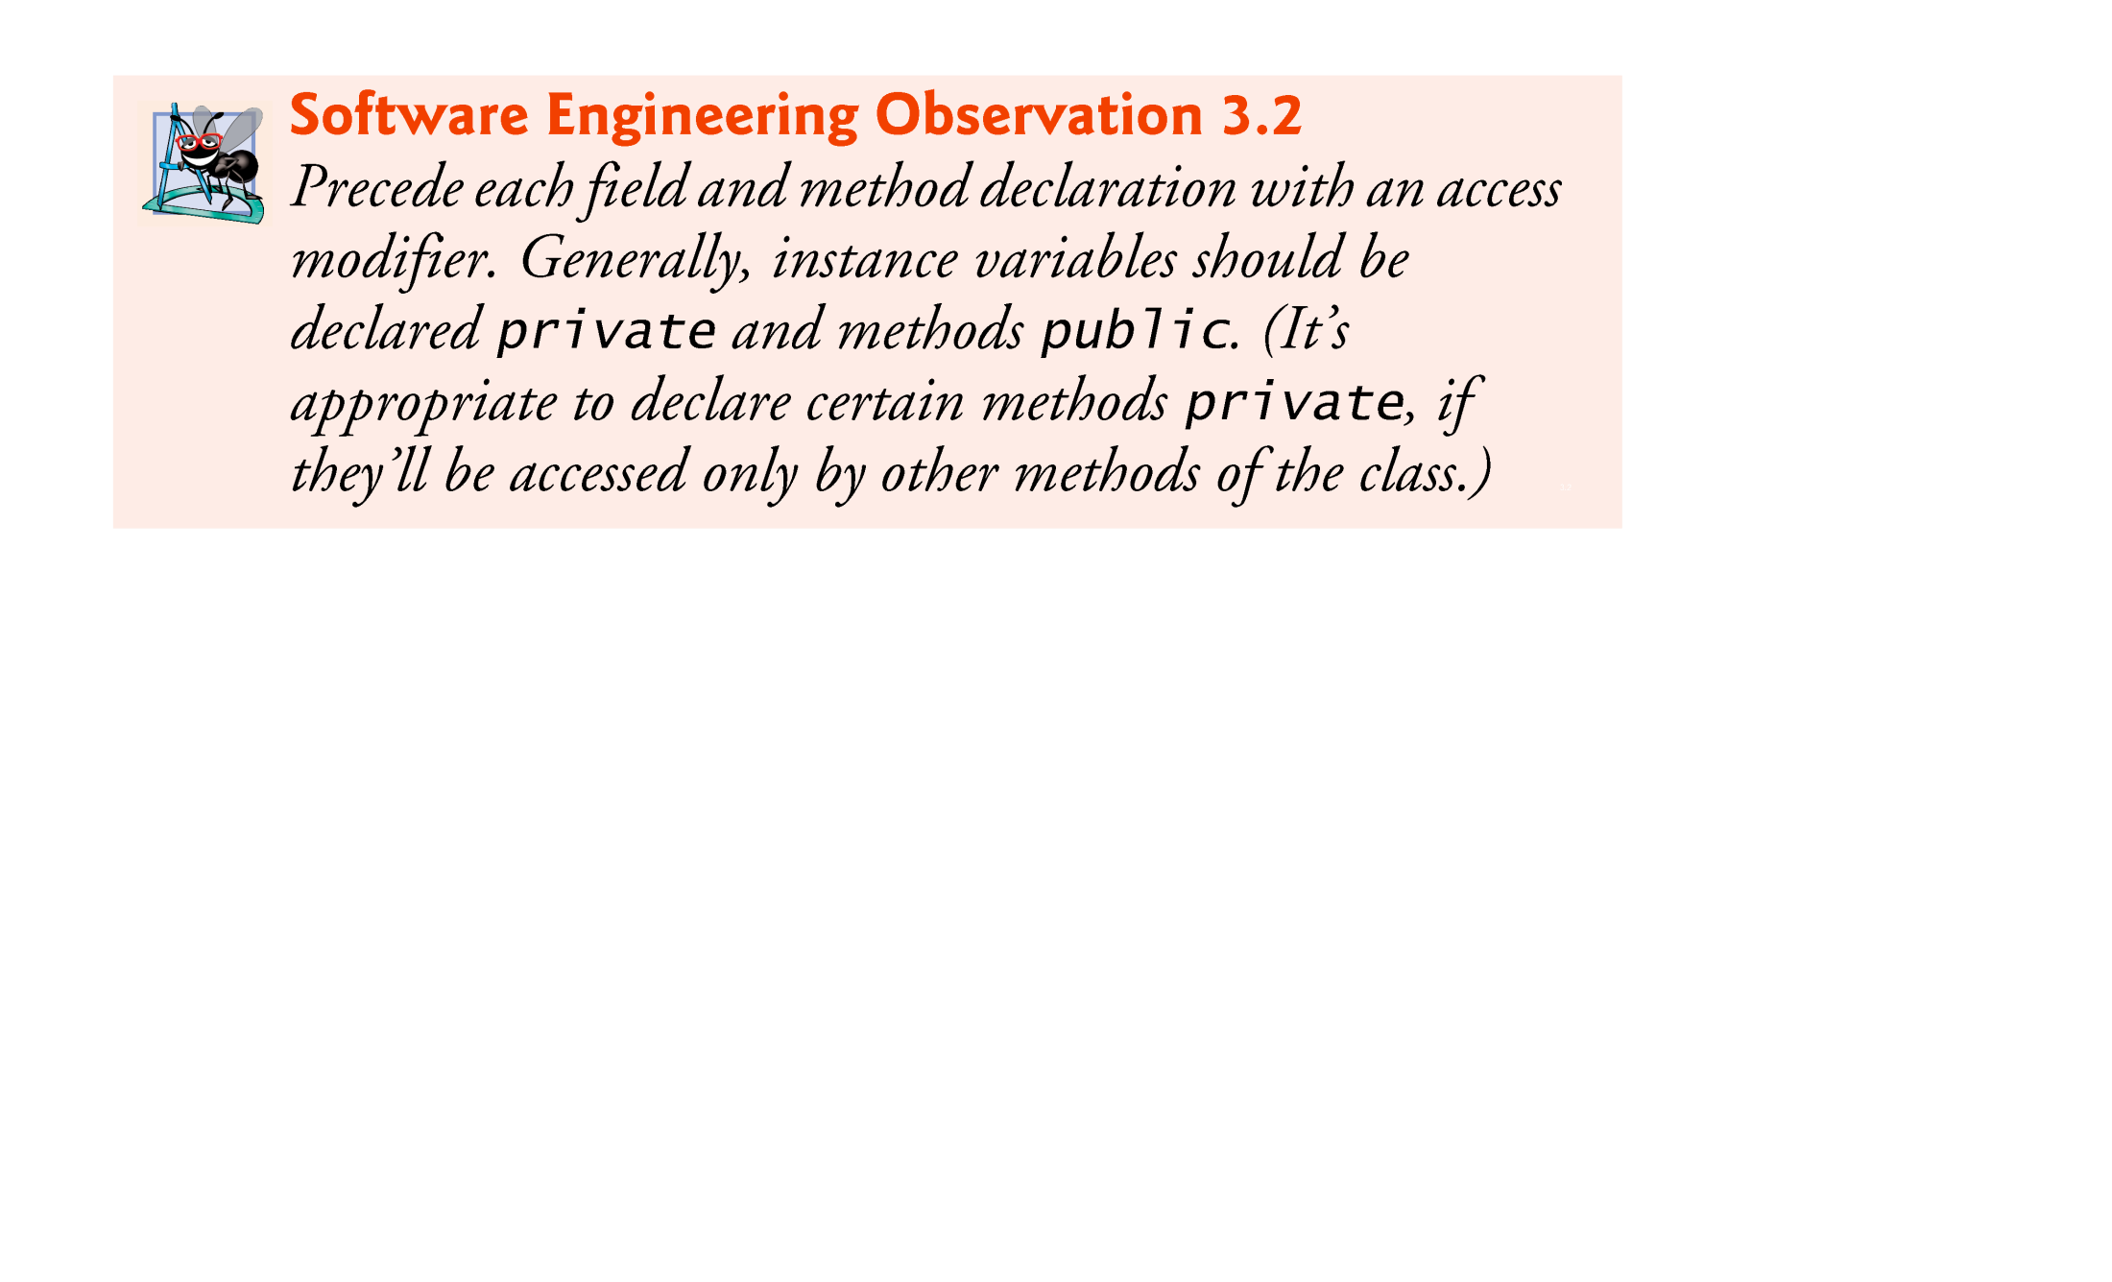
© Copyright 1992-2012 by Pearson Education, Inc. All Rights Reserved.

Slide 35
When a method that specifies a return type other than void completes its task, the method returns a result to its calling method.
Method setCourseName and getCourseName each use variable courseName even though it was not declared in any of the methods.
  Can use an instance variable of the class in each of the classes methods.
One method of a class can call another method of the same class by using just the method name.
  On the contrary, other classes need to create an object of the class whose method is to be called
© Copyright 1992-2012 by Pearson Education, Inc. All Rights Reserved.

Slide 36
Unlike local variables, which are not automatically initialized, every field has a default initial value—a value provided by Java when you do not specify the field’s initial value.
Fields are not required to be explicitly initialized before they are used in a program—unless they must be initialized to values other than their default values.
The default value for a field of type String is null
© Copyright 1992-2012 by Pearson Education, Inc. All Rights Reserved.

Slide 37
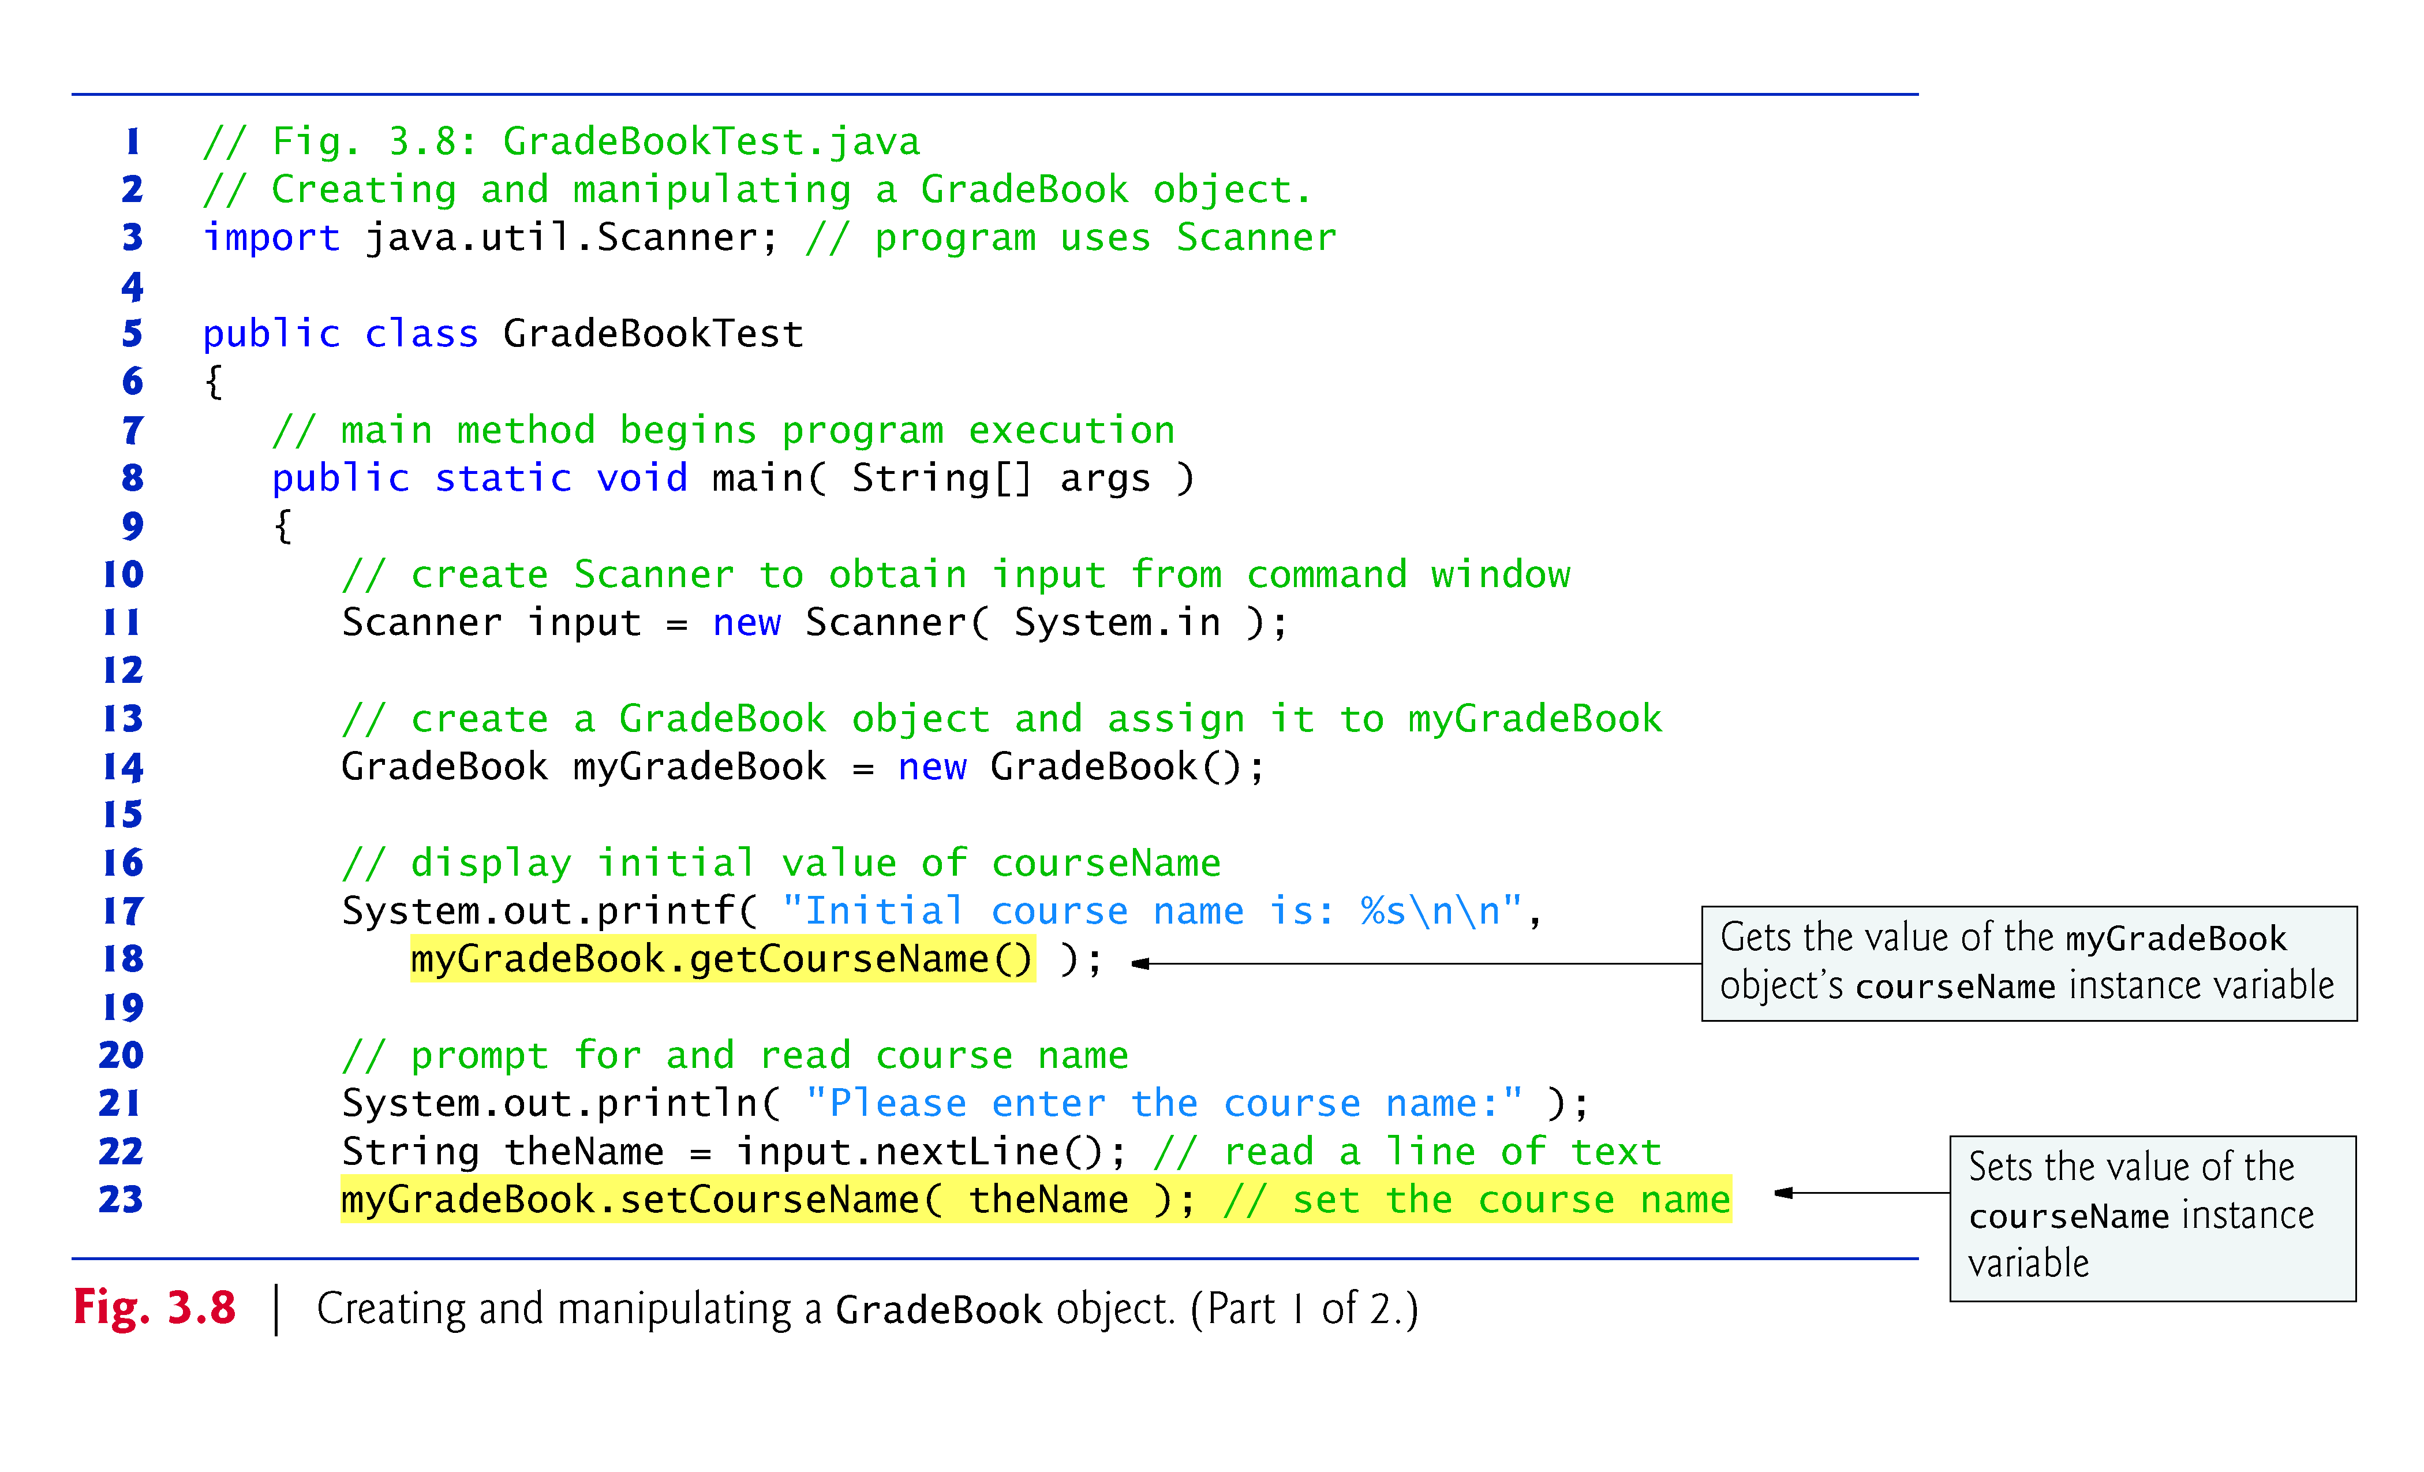
© Copyright 1992-2012 by Pearson Education, Inc. All Rights Reserved.

Slide 38
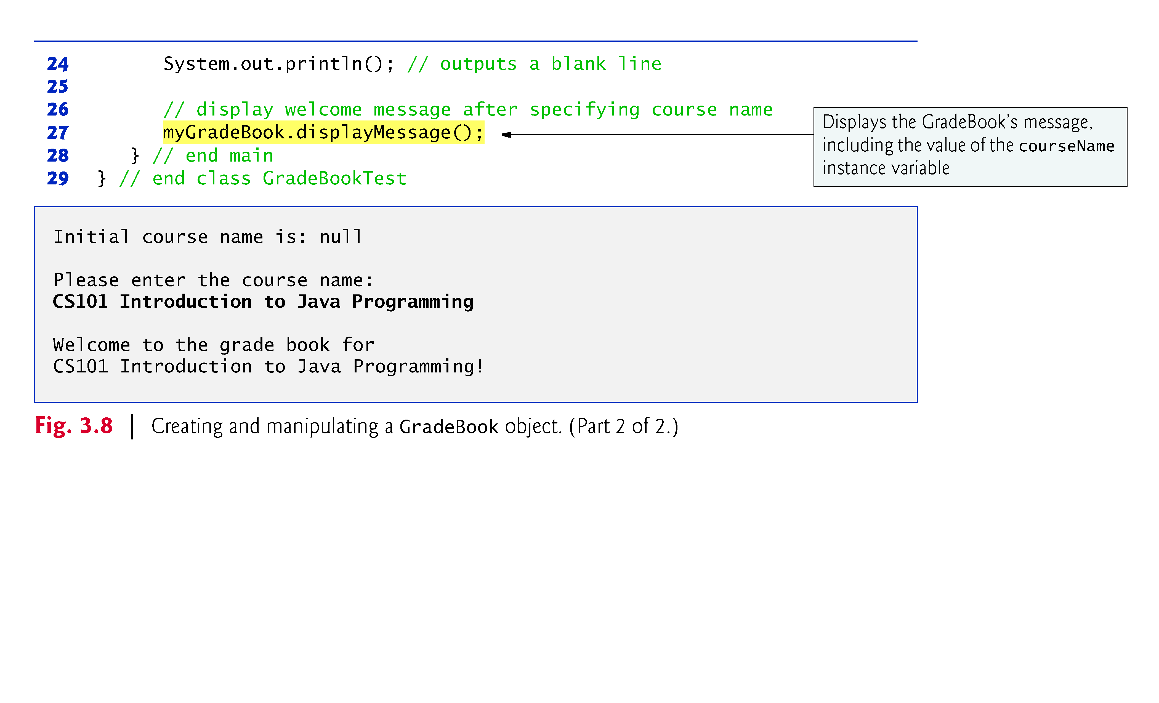
© Copyright 1992-2012 by Pearson Education, Inc. All Rights Reserved.

Slide 39
set and get methods
  A class’s private fields can be manipulated only by the class’s methods.
  A client of an object calls the class’s public methods to manipulate the private fields of an object of the class.
  Classes often provide public methods to allow clients to set (i.e., assign values to) or get (i.e., obtain the values of) private instance variables. These methods are termed as setter and getter methods respectively
  The names of these methods need not begin with set or get, but this naming convention is recommended.
© Copyright 1992-2012 by Pearson Education, Inc. All Rights Reserved.

Slide 40
Figure 3.9 contains an updated UML class diagram for the version of class GradeBook in Fig. 3.7.
  Models instance variable courseName as an attribute in the middle compartment of the class.
  The UML represents instance variables as attributes by listing the attribute name, followed by a colon and the attribute type.
  A minus sign (–) access modifier corresponds to access modifier private.
© Copyright 1992-2012 by Pearson Education, Inc. All Rights Reserved.

Slide 41
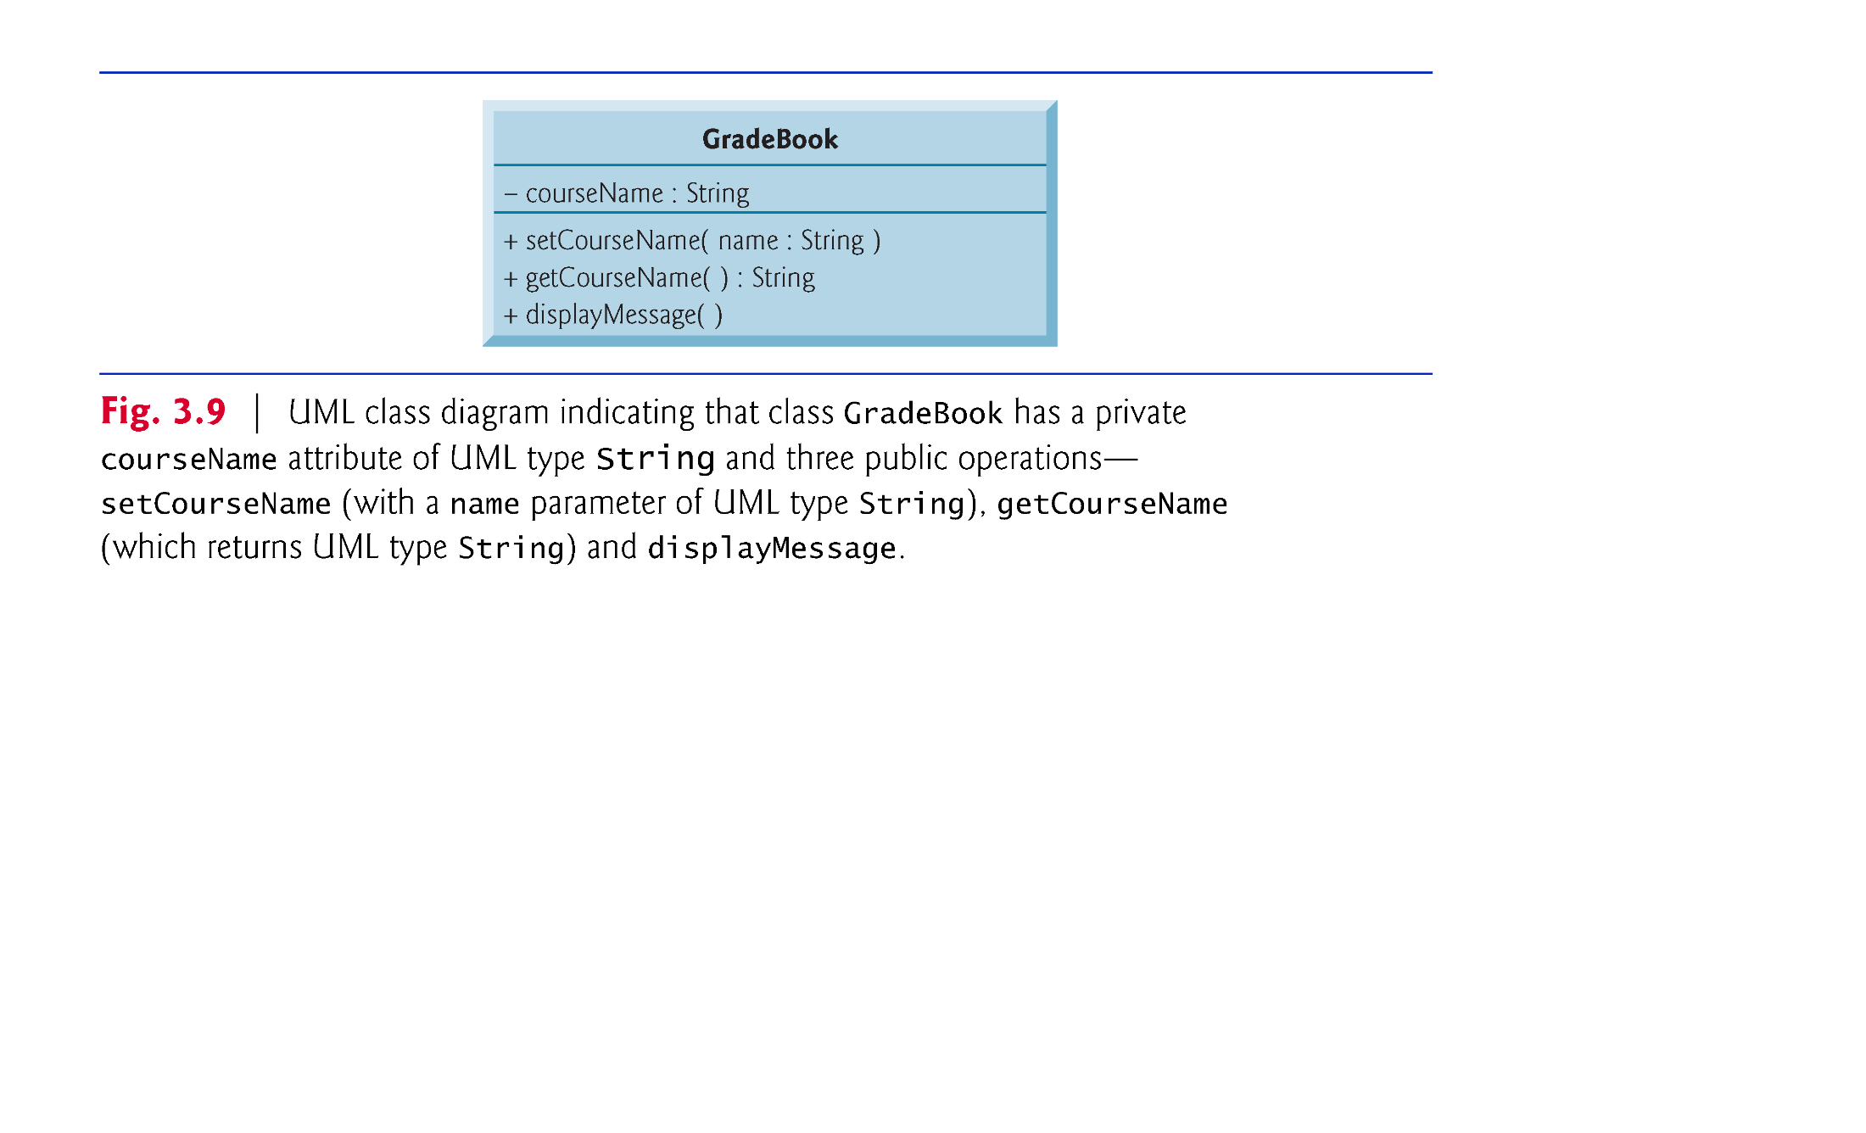
© Copyright 1992-2012 by Pearson Education, Inc. All Rights Reserved.

Slide 42
public class MobilePhone {
private int batteryPercentage;
private int signalStrength;
// Constructor
public MobilePhone(int battery, int signal) {
this.batteryPercentage = battery;
this.signalStrength = signal;
}
// Public methods
public void makeCall() {
System.out.println("Calling...");
// ... other logic
}
public void sendMessage() {
System.out.println("Sending message...");
// ... other logic
}
// Getter for batteryPercentage
public int getBatteryPercentage() {
return batteryPercentage;
}
// Setter for batteryPercentage
public void chargePhone(int chargeAmount) {
// This setter method ensures battery doesn't exceed 100% or fall below 0%
this.batteryPercentage = Math.min(100, this.batteryPercentage + chargeAmount);
this.batteryPercentage = Math.max(0, this.batteryPercentage);
}
// Getter for signalStrength
public int getSignalStrength() {
return signalStrength;
}
// ... Other methods, getters, and setters
}
© Copyright 1992-2012 by Pearson Education, Inc. All Rights Reserved.

Slide 43
© Copyright 1992-2012 by Pearson Education, Inc. All Rights Reserved.

Slide 44

When an object of a class is created, its instance variables are initialized by default.
Each class can provide a constructor that initializes an object of a class when the object is created.
Java requires a constructor call for every object that is created.
Keyword new requests memory from the system to store an object, then calls the corresponding class’s constructor to initialize the object.
A constructor MUST have the same name as the class.
© Copyright 1992-2012 by Pearson Education, Inc. All Rights Reserved.

Slide 45

By default, the compiler provides a default constructor in a class that does not explicitly include a constructor.
  Instance variables are initialized to their default values, e.g. integer type instance variables are assigned 0
Can provide your own constructor to specify custom initialization for objects of your class.
Like any method, a constructor can contain parameters, which can be used inside constructor to initialize instance variables.
Constructors cannot return values, so they cannot specify a return type.
Normally, constructors are declared public.
If you explicitly declare a constructor for a class, the Java compiler will not create a default constructor for that class.
© Copyright 1992-2012 by Pearson Education, Inc. All Rights Reserved.

Slide 46
© Copyright 1992-2012 by Pearson Education, Inc. All Rights Reserved.

Slide 47
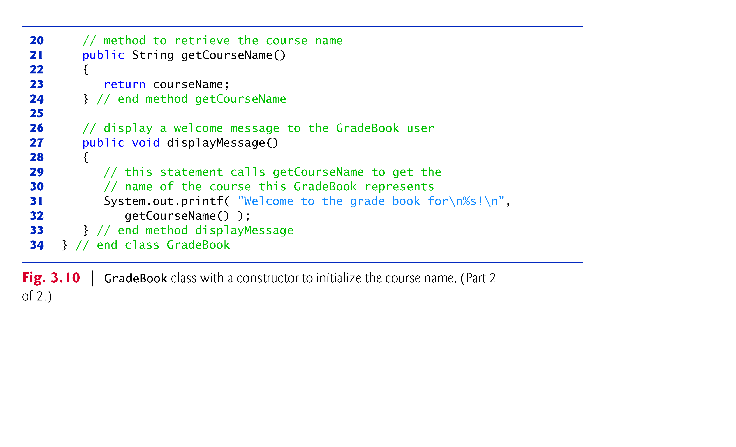
© Copyright 1992-2012 by Pearson Education, Inc. All Rights Reserved.

Slide 48
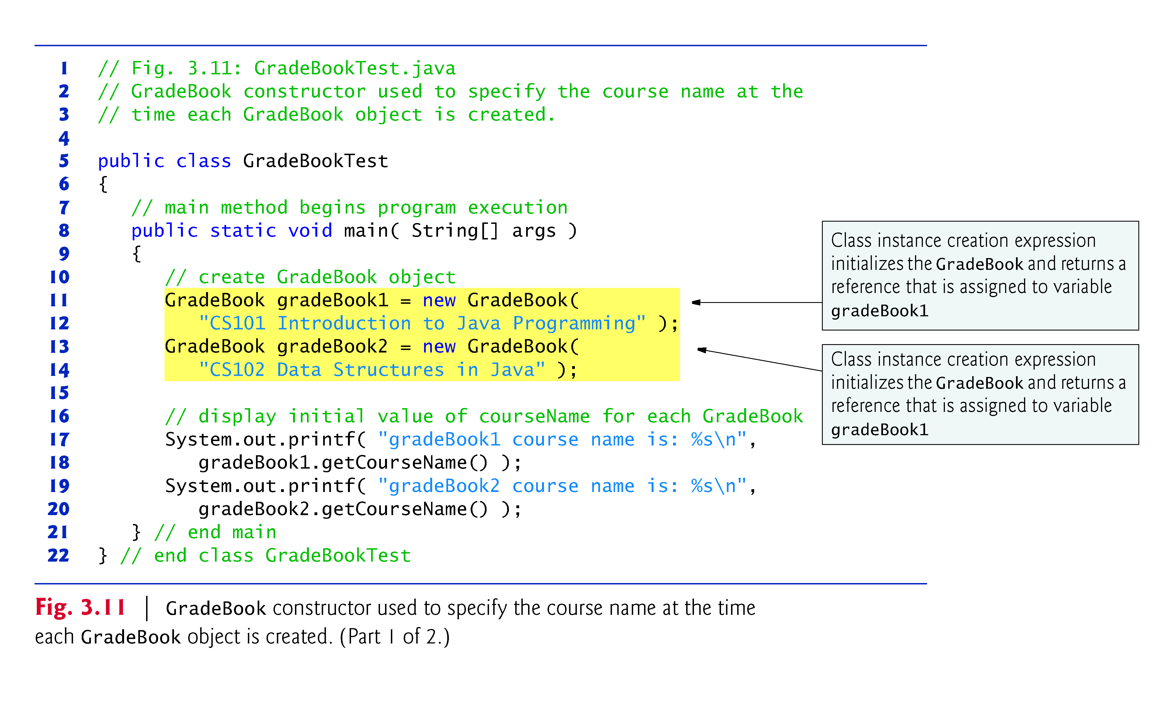
© Copyright 1992-2012 by Pearson Education, Inc. All Rights Reserved.

Slide 49
© Copyright 1992-2012 by Pearson Education, Inc. All Rights Reserved.

Slide 50
The UML class diagram of Fig. 3.12 models class GradeBook of Fig. 3.10, which has a constructor that has a name parameter of type String.
Like methods, the UML models constructors in the third compartment of a class in a class diagram.
To distinguish a constructor, the UML requires that the word “constructor” be placed between « and » before the constructor’s name.
List constructors before other operations in the third compartment.
© Copyright 1992-2012 by Pearson Education, Inc. All Rights Reserved.

Slide 51
© Copyright 1992-2012 by Pearson Education, Inc. All Rights Reserved.

Slide 52

In Java, Types are divided into primitive types and reference types.
The primitive types are boolean, byte, char, short, int, long, float and double.
A primitive-type variable can store exactly one value of its declared type at a time.
Primitive-type Instance variables are initialized by default—variables of types byte, char, short, int, long, float and double are initialized to 0, and variables of type boolean are initialized to false.
Primitive-type Local variables are NOT initialized by default
© Copyright 1992-2012 by Pearson Education, Inc. All Rights Reserved.

Slide 53
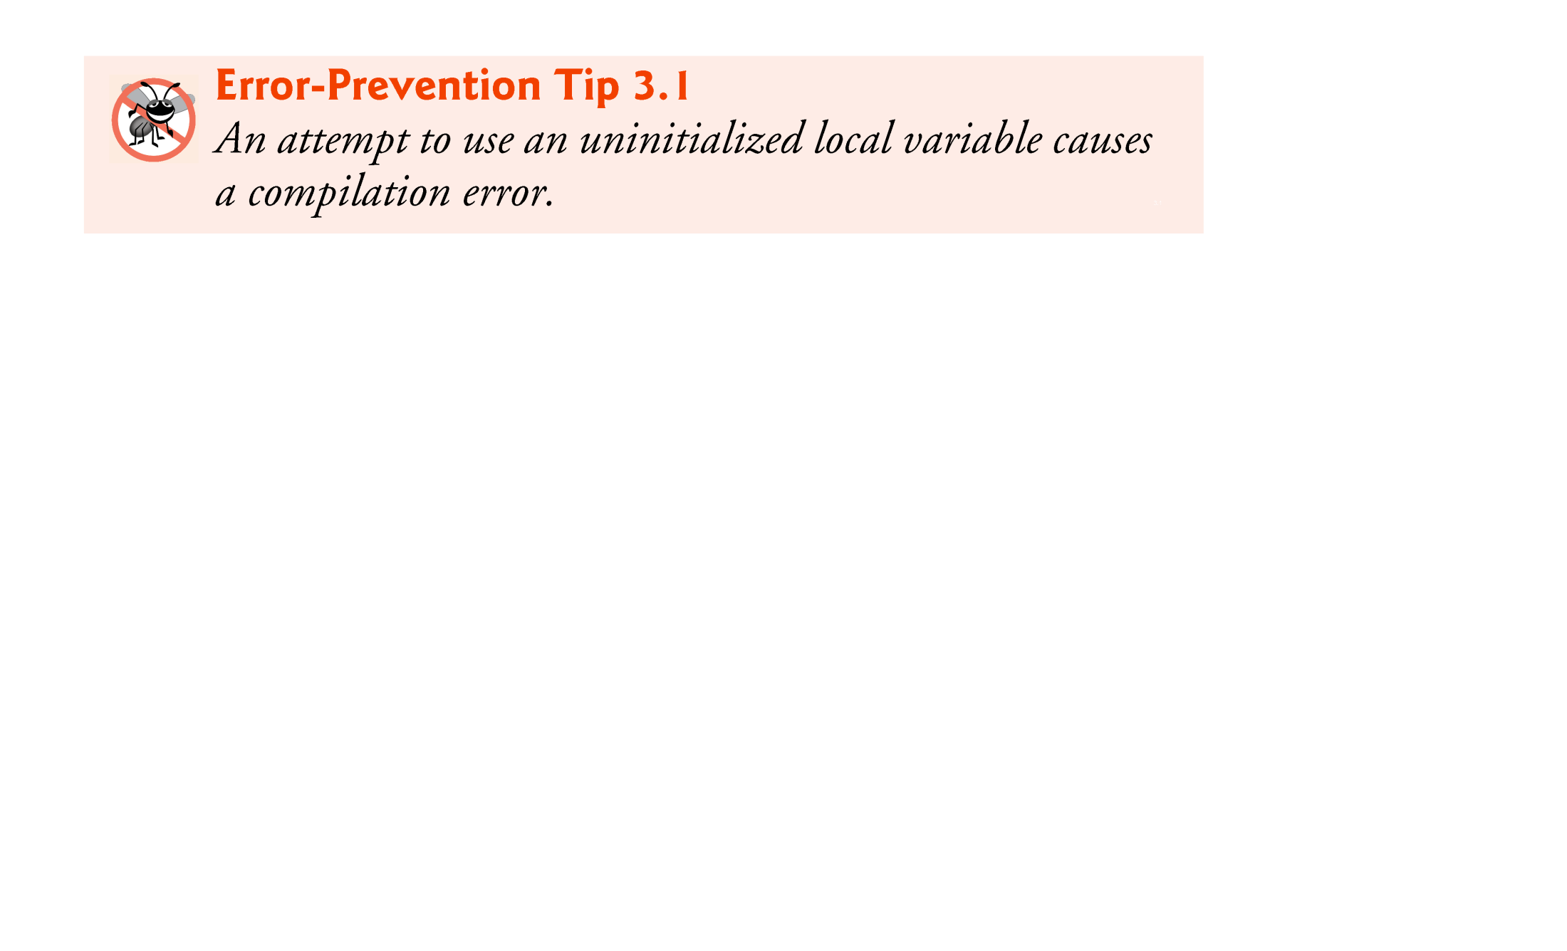
© Copyright 1992-2012 by Pearson Education, Inc. All Rights Reserved.

Slide 54
All non-primitive types (e.g. the class types) are reference types.
Programs use variables of reference types (normally called references) to store the locations of objects in the computer’s memory.
  The new keyword creates the object in memory
  Such a variable is said to refer to an object in the program.
Contrary to primitive types, objects that are referenced may each contain many instance variables and methods.
Reference-type instance variables are initialized by default to the value null
  A reserved word that represents a “reference to nothing.”
© Copyright 1992-2012 by Pearson Education, Inc. All Rights Reserved.

Slide 55
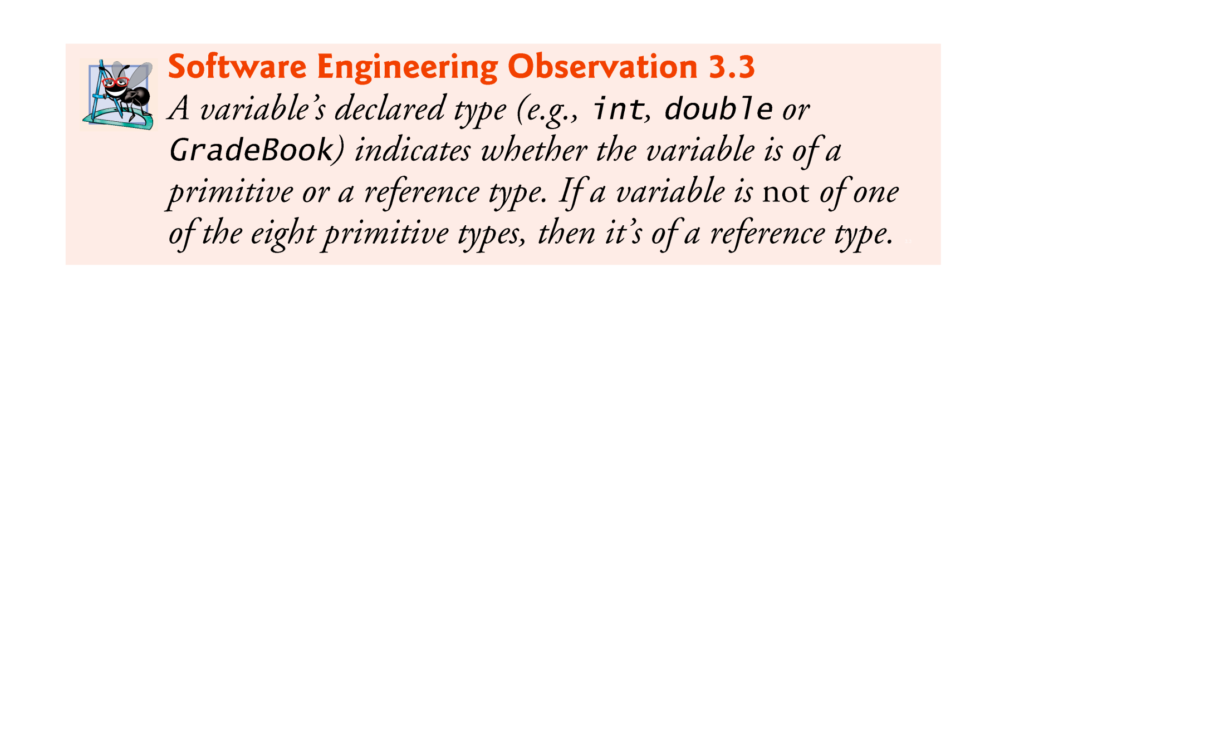
© Copyright 1992-2012 by Pearson Education, Inc. All Rights Reserved.

Slide 56
Optional Topics from now on …
© Copyright 1992-2012 by Pearson Education, Inc. All Rights Reserved.

Slide 57

Floating-point number
  A number with a decimal point, such as 7.33, 0.0975 or 1000.12345).
  float and double primitive types
  double variables can store numbers with larger magnitude and finer detail than float variables.
float represents single-precision floating-point numbers up to seven significant digits.
double represents double-precision floating-point numbers that require twice as much memory as float and provide 15 significant digits—approximately double the precision of float variables.
© Copyright 1992-2012 by Pearson Education, Inc. All Rights Reserved.

Slide 58

Java treats all floating-point literals (such as 7.33 and 0.0975) as double values by default.
Appendix D, Primitive Types shows the ranges of values for floats and doubles.
© Copyright 1992-2012 by Pearson Education, Inc. All Rights Reserved.

Slide 59
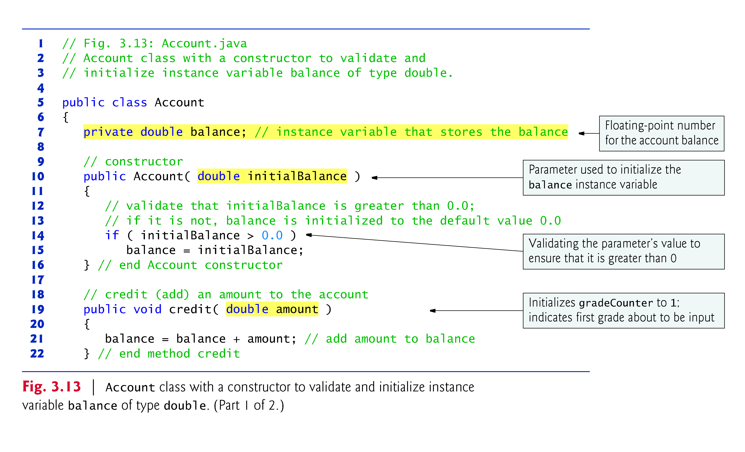
© Copyright 1992-2012 by Pearson Education, Inc. All Rights Reserved.

Slide 60
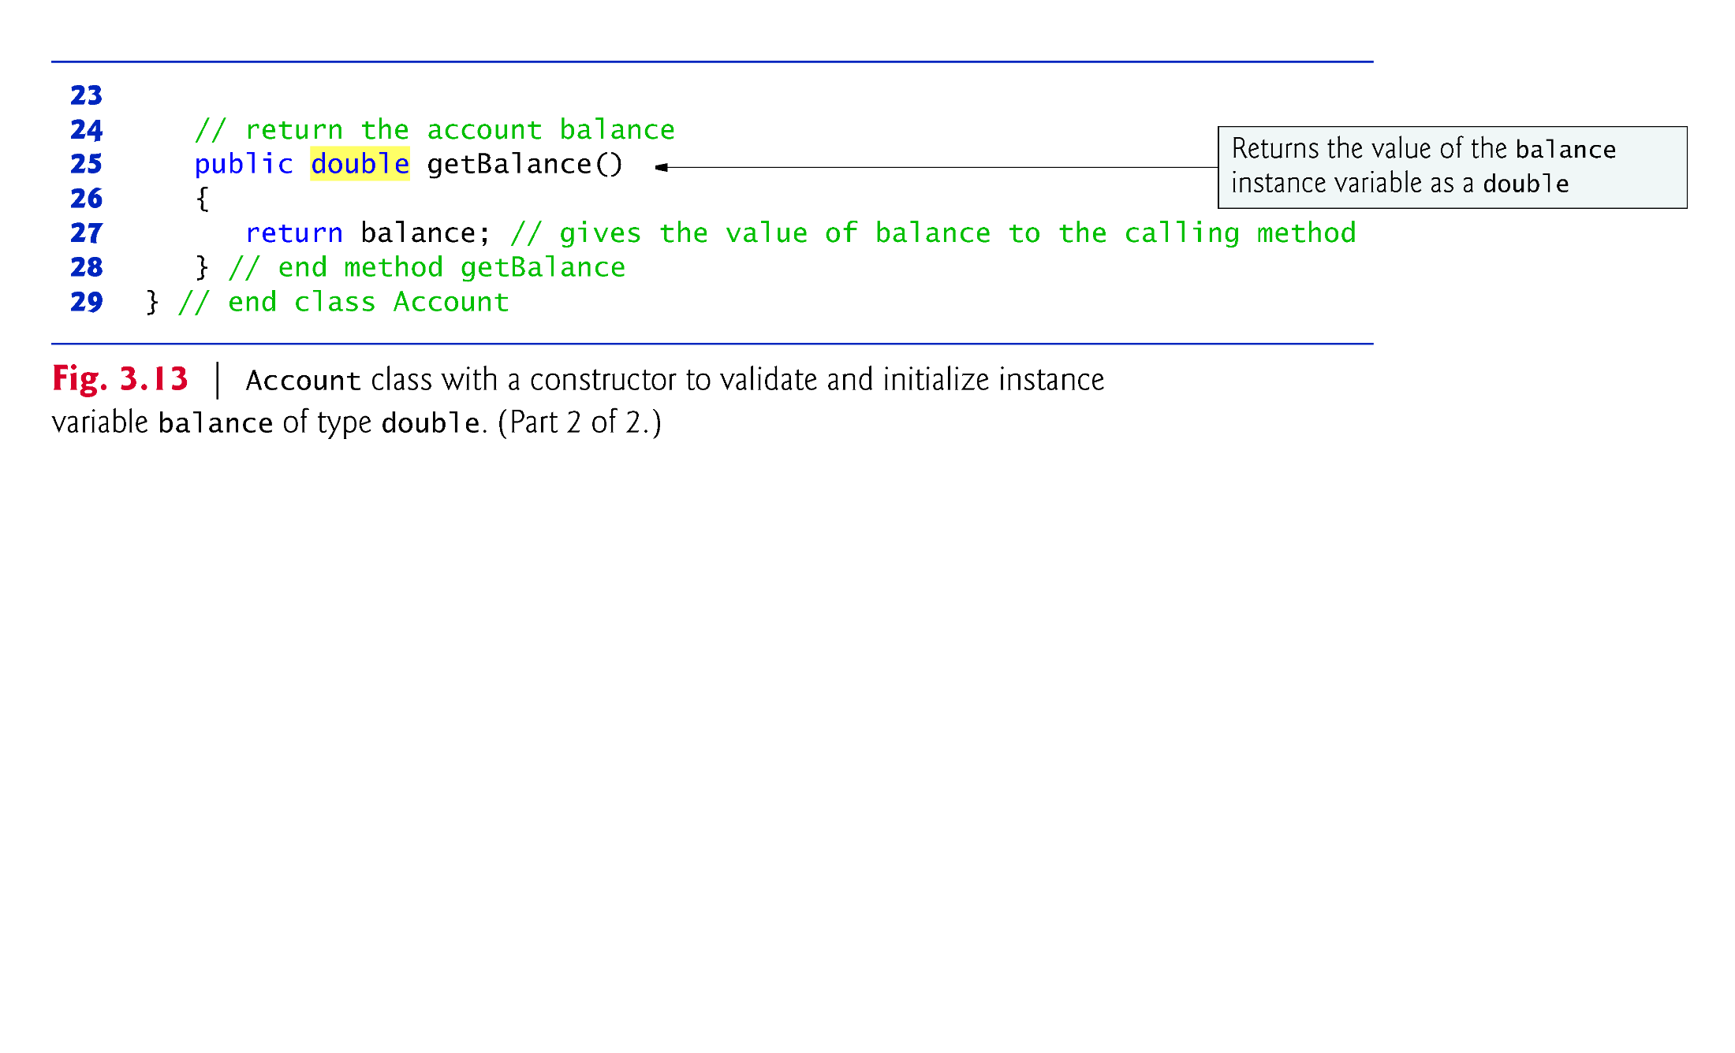
© Copyright 1992-2012 by Pearson Education, Inc. All Rights Reserved.

Slide 61
System.out.printf
  Format specifier %.2f
  %f is used to output values of type float or double.
  .2 represents the number of decimal places (2) to output to the right of the decimal point—known as the number’s precision.
  Any floating-point value output with %.2f will be rounded to the hundredths position.
Scanner method nextDouble returns a double value entered by the user.
© Copyright 1992-2012 by Pearson Education, Inc. All Rights Reserved.

Slide 62
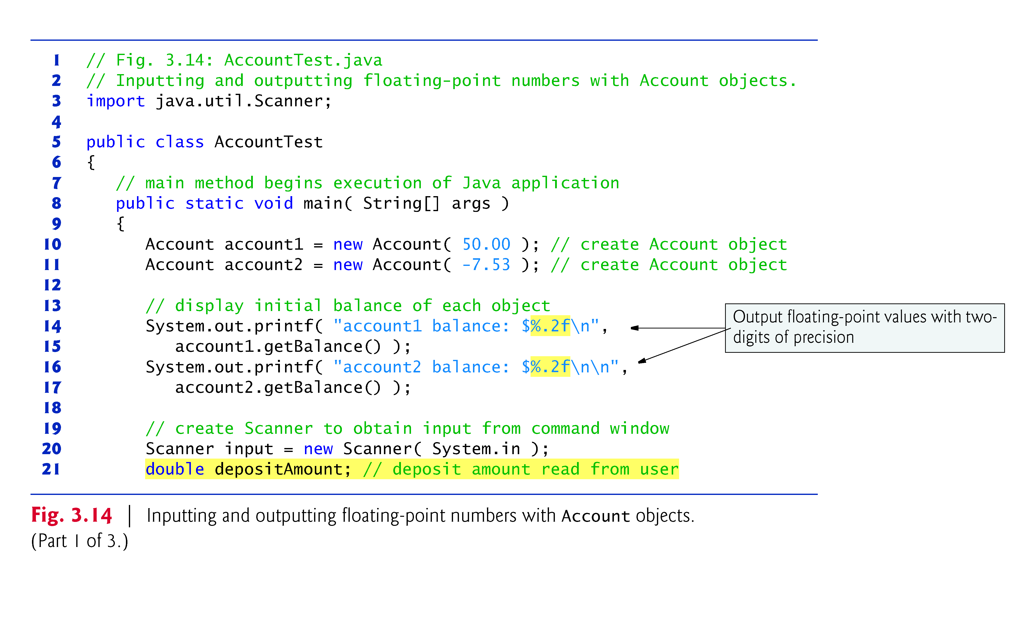
© Copyright 1992-2012 by Pearson Education, Inc. All Rights Reserved.

Slide 63
© Copyright 1992-2012 by Pearson Education, Inc. All Rights Reserved.

Slide 64
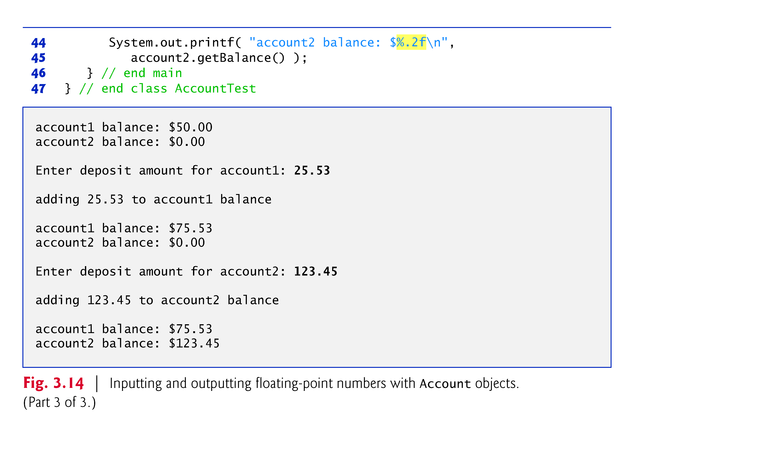
© Copyright 1992-2012 by Pearson Education, Inc. All Rights Reserved.

Slide 65
The UML class diagram in Fig. 3.15 models class Account of Fig. 3.13.
© Copyright 1992-2012 by Pearson Education, Inc. All Rights Reserved.

Slide 66
© Copyright 1992-2012 by Pearson Education, Inc. All Rights Reserved.

